Slide 1
NEU Proteomics Capstone Module: Case Studies in Quantitative Proteomics
Jacob D. Jaffe, Lev Litichevski, Jarrett Egerston, Mike MacCoss, Meena Choi, Olga Vitek
w/ special guest: Ruedi Aebersold

Slide 2
Goals for this course
Understand the concepts and value of a proteomic sentinel assay
Understand the considerations in moving from discovery proteomics data to targeted proteomics
Practical: Selection of probes for a targeted proteomics sentinel assay
Understand considerations for treatment and normalization of research grade targeted proteomics assays
Practical: Construct your own data processing pipeline
Introduction to next-gen MS methods to expand targeted panels
Understand the conceptual differences between using markers and profiles of activity
Introduction to the concept of connectivity and exploration of the dataset in this space

Slide 3
Key Differences from Previous Modules
This is the first time we have attempted this course
Expect some bumps in the road!
Hackathons, not exercises
Put into practice all you have learned so far
Team-based work
There are no right or wrong answers
Key learning comes from sharing of experiences

Slide 4
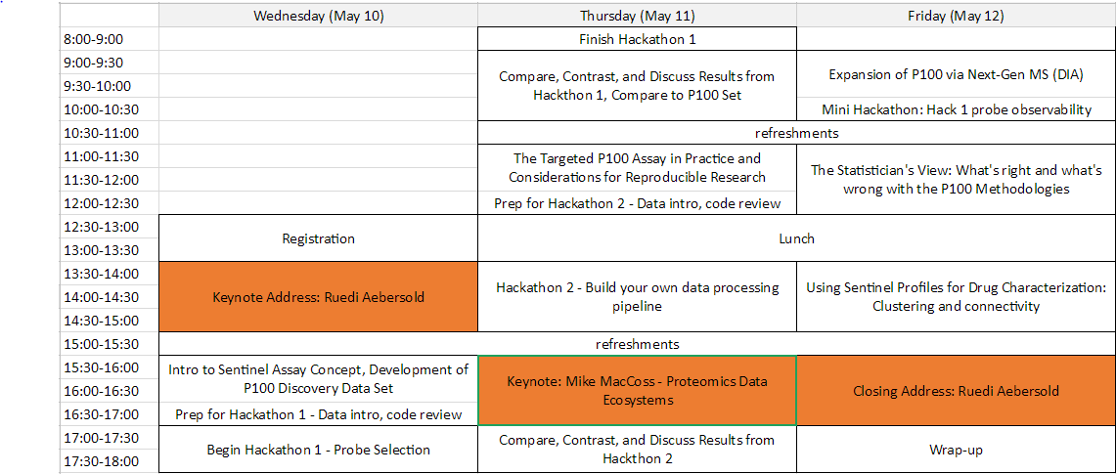
Course Structure

Slide 5
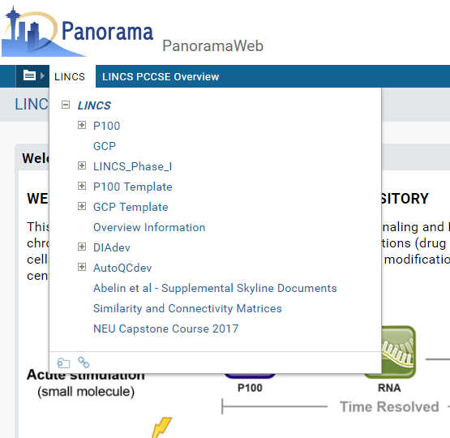
Everything you need:
bit.ly/PCCSEData

Slide 6
Lecture 1: Targeted Proteomics, the Sentinel Assay Concept, and Initial Development of the P100 Assay
Jacob D. Jaffe

Slide 7
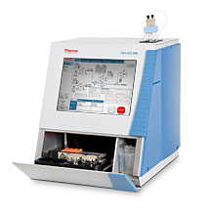
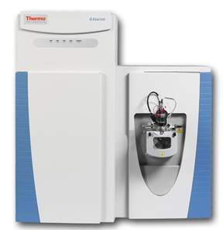
Targeted vs. Discovery Proteomics
LC
MS Analyzer
Samples
Shotgun Proteomics
Targeted Proteomics
Complex sample is interrogated stochastically
Get protein/peptide IDs
Irreproducible repeats
Focus efforts on relatively fewer analytes
Verify ID, get quantification
Consistency
Notes:
Global discovery vs. targeted message

Slide 8
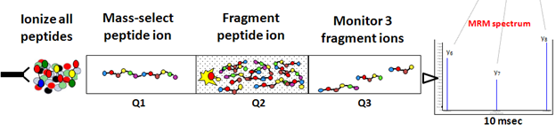
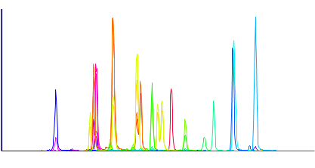
Targeted MS: Experimental Implementation
Monitor Specific
Q3 / Hi-res MS
Signal
Assay time
100s of analytes in a single experiment
Synthetic peptide internal standards – quantification and proof of ID
When you want to guarantee you measure it each and every time!

Slide 9
Why do targeted studies?
Instrumentation inherently undersamples population
Speed
Sensitivity
Dynamic Range
Peptide A
Peptide B
Peptide C
Peptide D
Peptide E
Peptide F
Peptide G
Peptide H
Peptide I
Peptide J
Peptide K
Peptide L
LCMS Experiment #1
Peptide H
Peptide I
Peptide J
Peptide K
Peptide L
Peptide M
Peptide N
Peptide O
Peptide P
Peptide Q
Peptide R
Peptide S
LCMS Experiment #2

Slide 10
Data Shapes in Proteomics
1. Long and skinny
2. Short and wide
3. Hole-y
Peptides/proteins

Slide 11

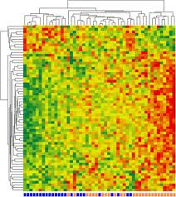
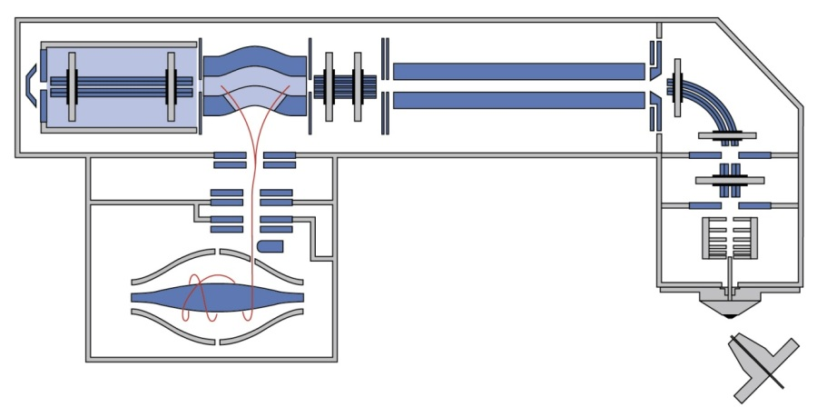

It’s hard to be hole-y
X
Instrument Jockeys
Data Geniuses
OUTERSPACE VACUUM!
QUADRUPOLES!?!
2000 VOLTS!
HIGH ELECTROSTATIC FIELDS

Slide 12
The Sentinel Assay Concept

Slide 13
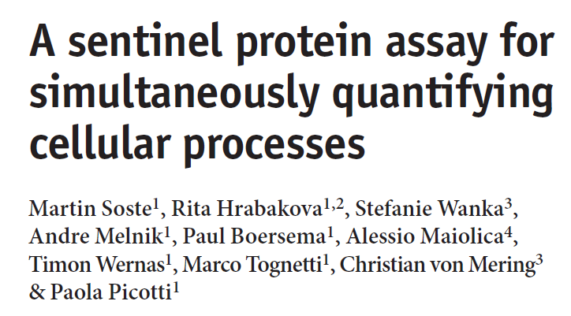
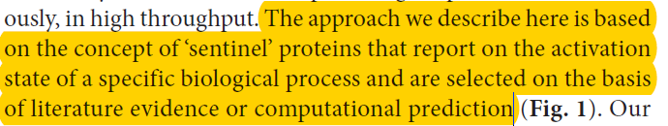
A Sentinel Assay for Yeast Biology
Two targeted proteomics assays:
Protein
Phosphopeptide
Characterizes a range of biochemical responses to stimulation
Targets nominated by literature, prior knowledge
Nature Methods 11:1045-8 (2014)

Slide 14
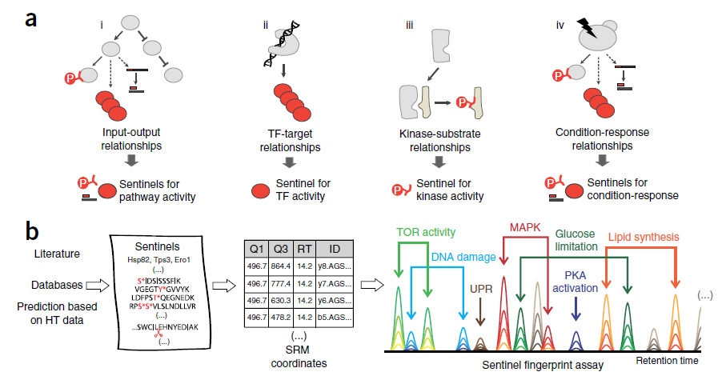
A Sentinel Assay for Yeast Biology
Fig. 1 from Soste et al., Nature Methods 11:1045-8 (2014)

Slide 15
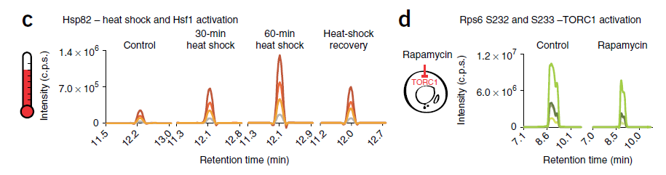
Examples of Specific Sentinel Behaviors
Selected from Fig. 3 from Soste et al., Nature Methods 11:1045-8 (2014)

Slide 16
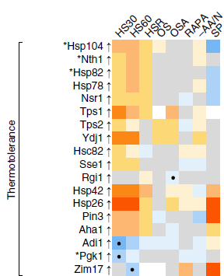
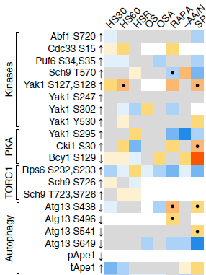
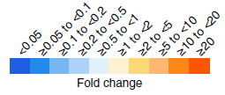
Examples of Sentinel Reporting Profiles
Protein Level Reporters
Phospho Level Reporters
On-target stimuli
HS30 = Heat shock 30’
HS60 = Heat shock 60’
HSP = Heat shock recovery
OS = osmotic stress
OSA = osmotic stress adapted
RAPA = rapamycin
-AA/N = amino acid and nitrogen starvation
SP = stationary phase
differs from anticipated
response
Selected from Fig. 2 from Soste et al., Nature Methods 11:1045-8 (2014)

Slide 17
Considerations for Translating to a Human Sentinel Assay
Human proteome/phosphoproteome is bigger
Pathway architecture in human cells is more complex
Probably less direct knowledge as to what the sentinels would be
Proteomic accessibility of desired sentinel peptides
Diversity of biology and cell types coupled with proteome dynamic range might make life difficult

Slide 18
Reduced Representation Phosphosignaling
“P100” – A different kind of sentinel assay

Slide 19
Why phosphoproteomics?
Classic “pathways” are commonly represented as signaling cascades of phosphoproteomic events
Phosphoproteomic events are the “first responders” of cells and occur on a range of time scales from minutes to days
Phosphoproteins are not easily quantified using nucleic acid based techniques
Kinase inhibitors are a major class of emerging therapeutics

Slide 20
Reduced Representation Signaling Set: P100
Phosphosignaling is likely coordinated
Kinase-substrate relationships tend to be 1-to-many
A priori expectation of coordinate regulation of sites
Don’t need to monitor every phosphosite all the time?
Amenable to reductionist approaches?

Slide 21
Final goals of P100 assay development
Drug responsiveness
Universal (-ish)
Ser/Thr focused
Compact
Operates at scale
Longitudinally comparable

Slide 22
Major Problem #1: No easily usable prior data
Many piecemeal, ad hoc drug studies
1 or 2 drugs
Many focus on pTyr signaling
Wide range of biological models
Inconsistent data reporting formats
General lack of systematic studies
We decided to make our own
Discovery proteomics
Quantitation by SILAC

Slide 23
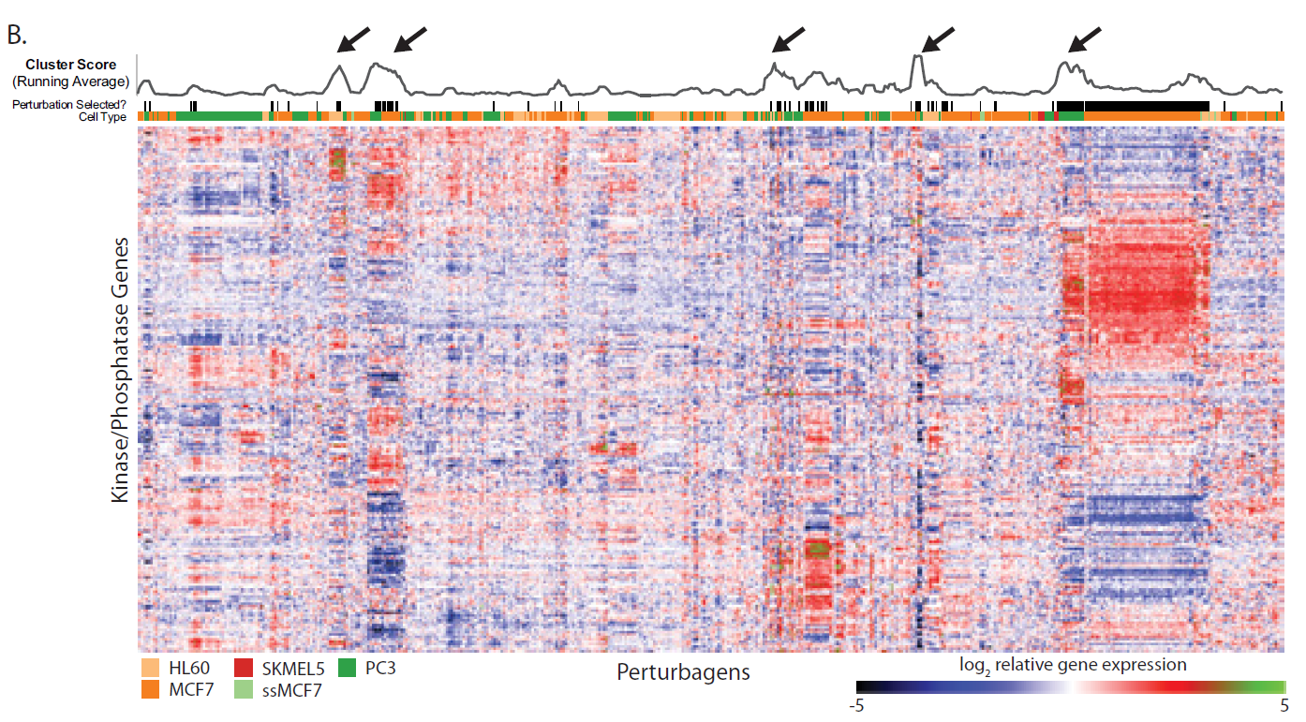
Selection of Compounds for Systematic Data Generation
Start with gene expression profiles induced by drug treatment
Multiple cell types
Extract kinase/phosphatase genes
Abelin et al., Mol. Cell. Proteomics 15:1622-41 (2016)

Slide 24
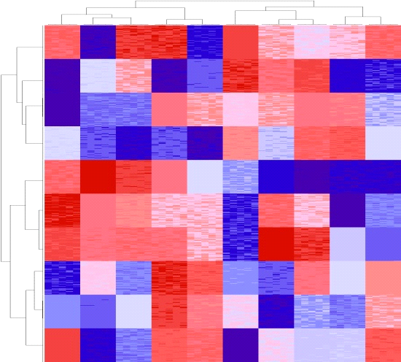
Generation of foundational data
Select representative phosphopeptide probes from coherent clusters
Compound
captopril
ambroxol
paclitaxel
carmustine
fulvestrant
clindamycin
chlortetracycline
chlorzoxazone
doxorubicin
daunorubicin
GW-8510
staurosporine
dexverapamil
mesalazine
anisomycin
digitoxigenin
digoxigenin
digoxin
lanatoside C
irinotecan
scriptaid
trichostatin A
MS-275
H-7
geldanamycin
valproic acid
MCF7
(breast cancer)
Cell Lines/Conditions
2
PC3
(prostate cancer)
X
X
→
Phosphosites
HL60
(acute promyelocytic leukemia)
Chosen based on:
Modulates kinase/phosphatase expression
Concentration from CMAP
Have matching gene expression data
Several same class examples
PosCon = staurosporine
Jinal Patel, Xiaodong Lu

Slide 25
SILAC and Stable Isotopes: Let cells do the work
Feed cells growth medium with “heavy” amino acids
Proteins incorporate these amino acids
All proteins are slightly “heavier” but otherwise biochemically equivalent
Choice of Lys and Arg typical because of trypsin
Arg₁₀, Lys₈
6-7 doublings

Slide 26
SILAC-based discovery profiling
Cleanup
Cells pre-labeled by SILAC
Treatments: 6 hours, concentrations from gene expression study
IMAC-based phosphopeptide enrichment
Primary yield: Ser/Thr
Mass spec provides both ID (MS2) and quantification (MS1)

Slide 27
Considerations for successful assay configuration
Are there a set of phosphosites that we can (almost) always observe?
Do these phosphosites behave in interesting ways in response to perturbations?
Do we gain anything over gene expression measurements?
Can we pick a (small) set of highly informative phosphopeptides?
Could profiling these peptides reproduce the observations of a deeper experiment?
Is the assay generally useful?

Slide 28
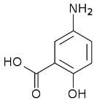
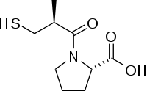
Experimental Implementation
L
x13
DMSO
M
x13
H
x13
1.5 days
2 days
3 days
3 days
6 hours
Timing Estimates
MCF7-1
PC3-1
HL60-1
MCF7-2
PC3-2
HL60-2
Week -2
Week 1
Week 7
More than 7.5 x 10⁸ cells grown for experiments!
True bio-replicates
Xiaodong Lu, Jinal Patel

Slide 29
Computational Fractionation Acquisition Strategy
All experiments performed on a Q-Exactive mass spectrometer
2 hour, “Top 12” shotgun proteomics experiments
Each sample analyzed 3 times:
Run 1: Top12
Run 2: Top12 AMEX
Run 3: Top12 AIMS
See what’s there
See what else is there
Fill in the blanks
Primary interpretation and quantification in MaxQuant
Rudomin et al., J. Proteome Res 8:3145-60 (2009)
Jaffe et al., Mol. Cell. Proteomics 7:1952-62 (2008)

Slide 30
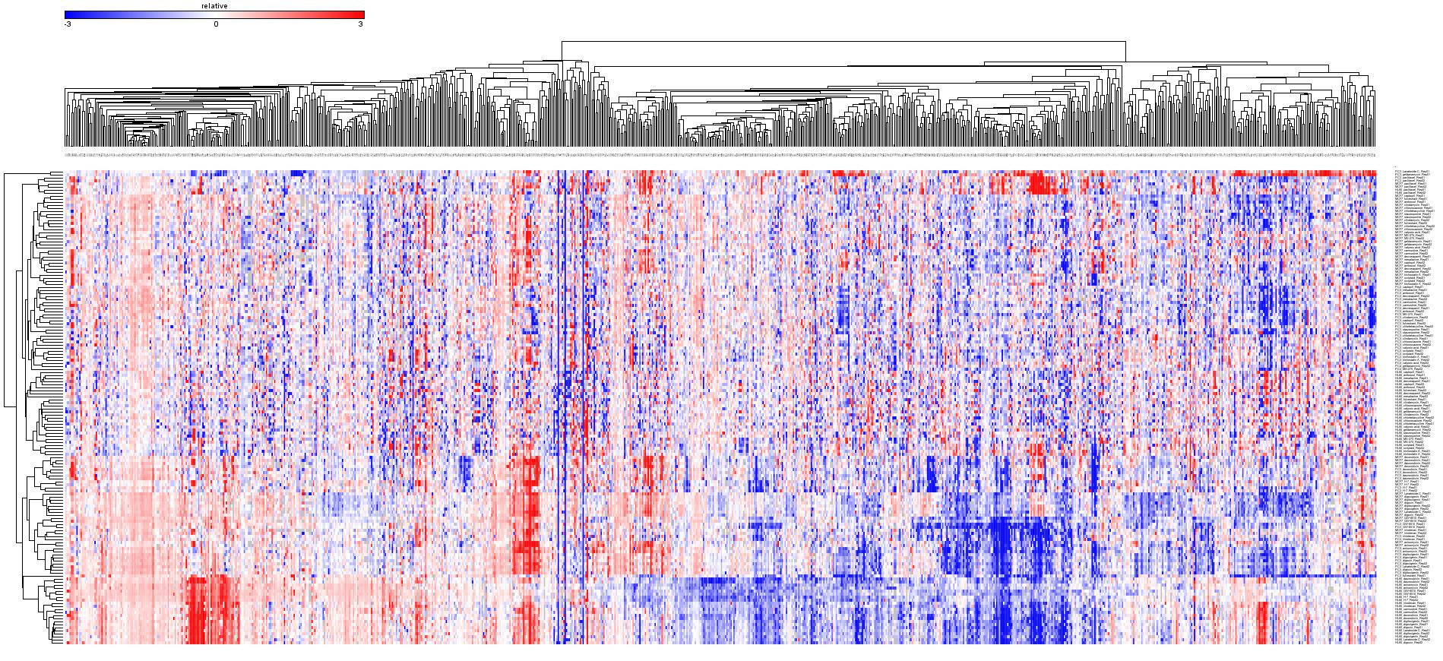
P100 Source Dataset
Jinal Patel, Xiaodong Lu
Sites
Treatments/Cell lines
Large systematic set of perturbations with phosphoproteomics readout
Over 10,000 phosphosites observed
Over 1,200 sites present in >75% of all experiments

Slide 31
Will it work?
Are there a set of phosphosites that we can (almost) always observe?
Do these phosphosites behave in interesting ways in response to perturbations?
Do we gain anything over gene expression measurements?
Can we pick a (small) set of highly informative phosphopeptides?
Could profiling these peptides reproduce the observations of a deeper experiment?
Is the assay generally useful?

Slide 32
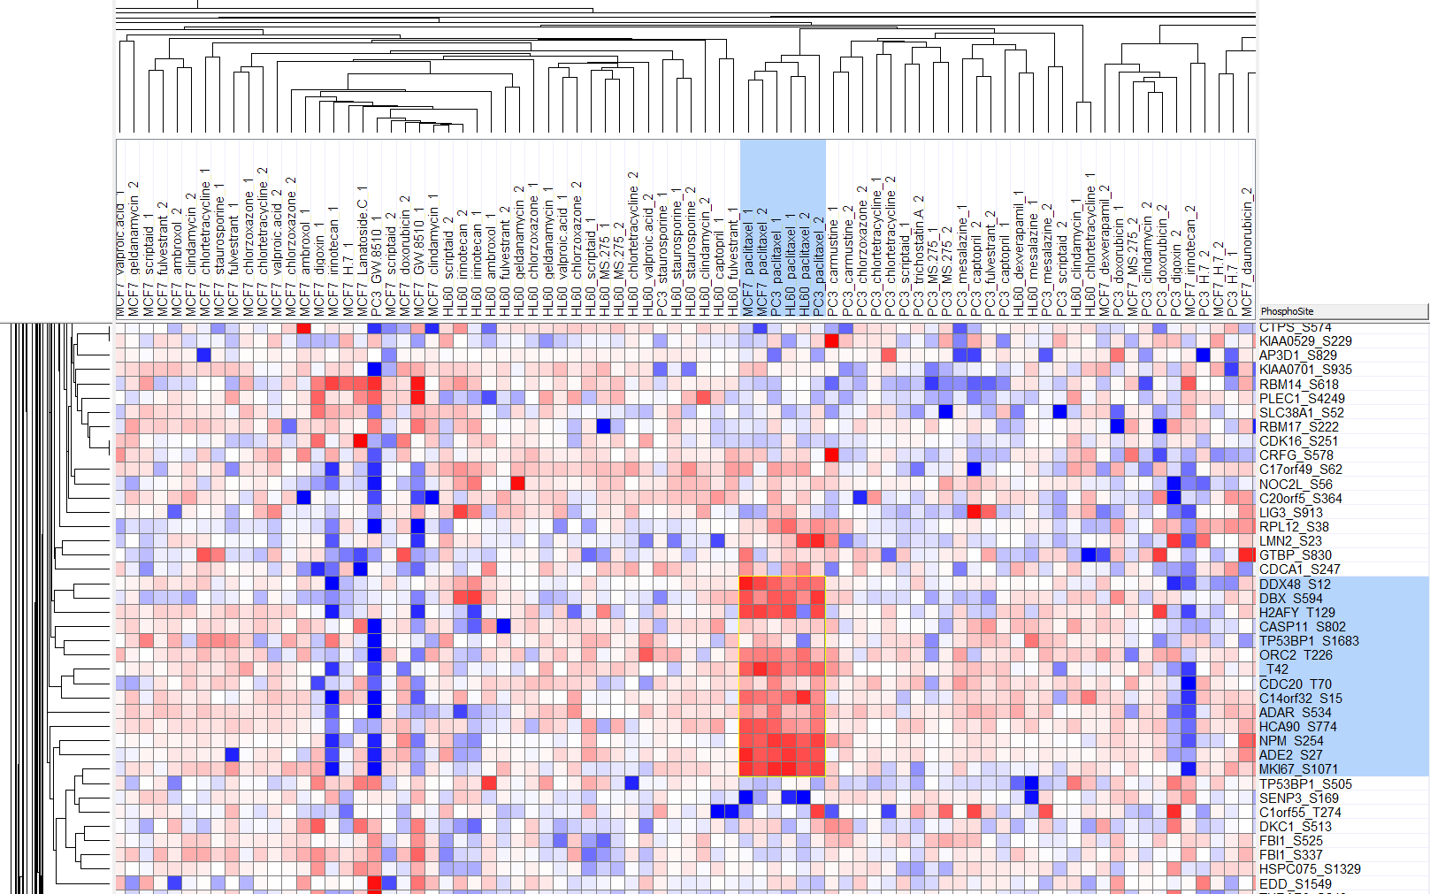
Signals span lineages
All 6 Taxol treatments cluster – regardless of lineage

Slide 33
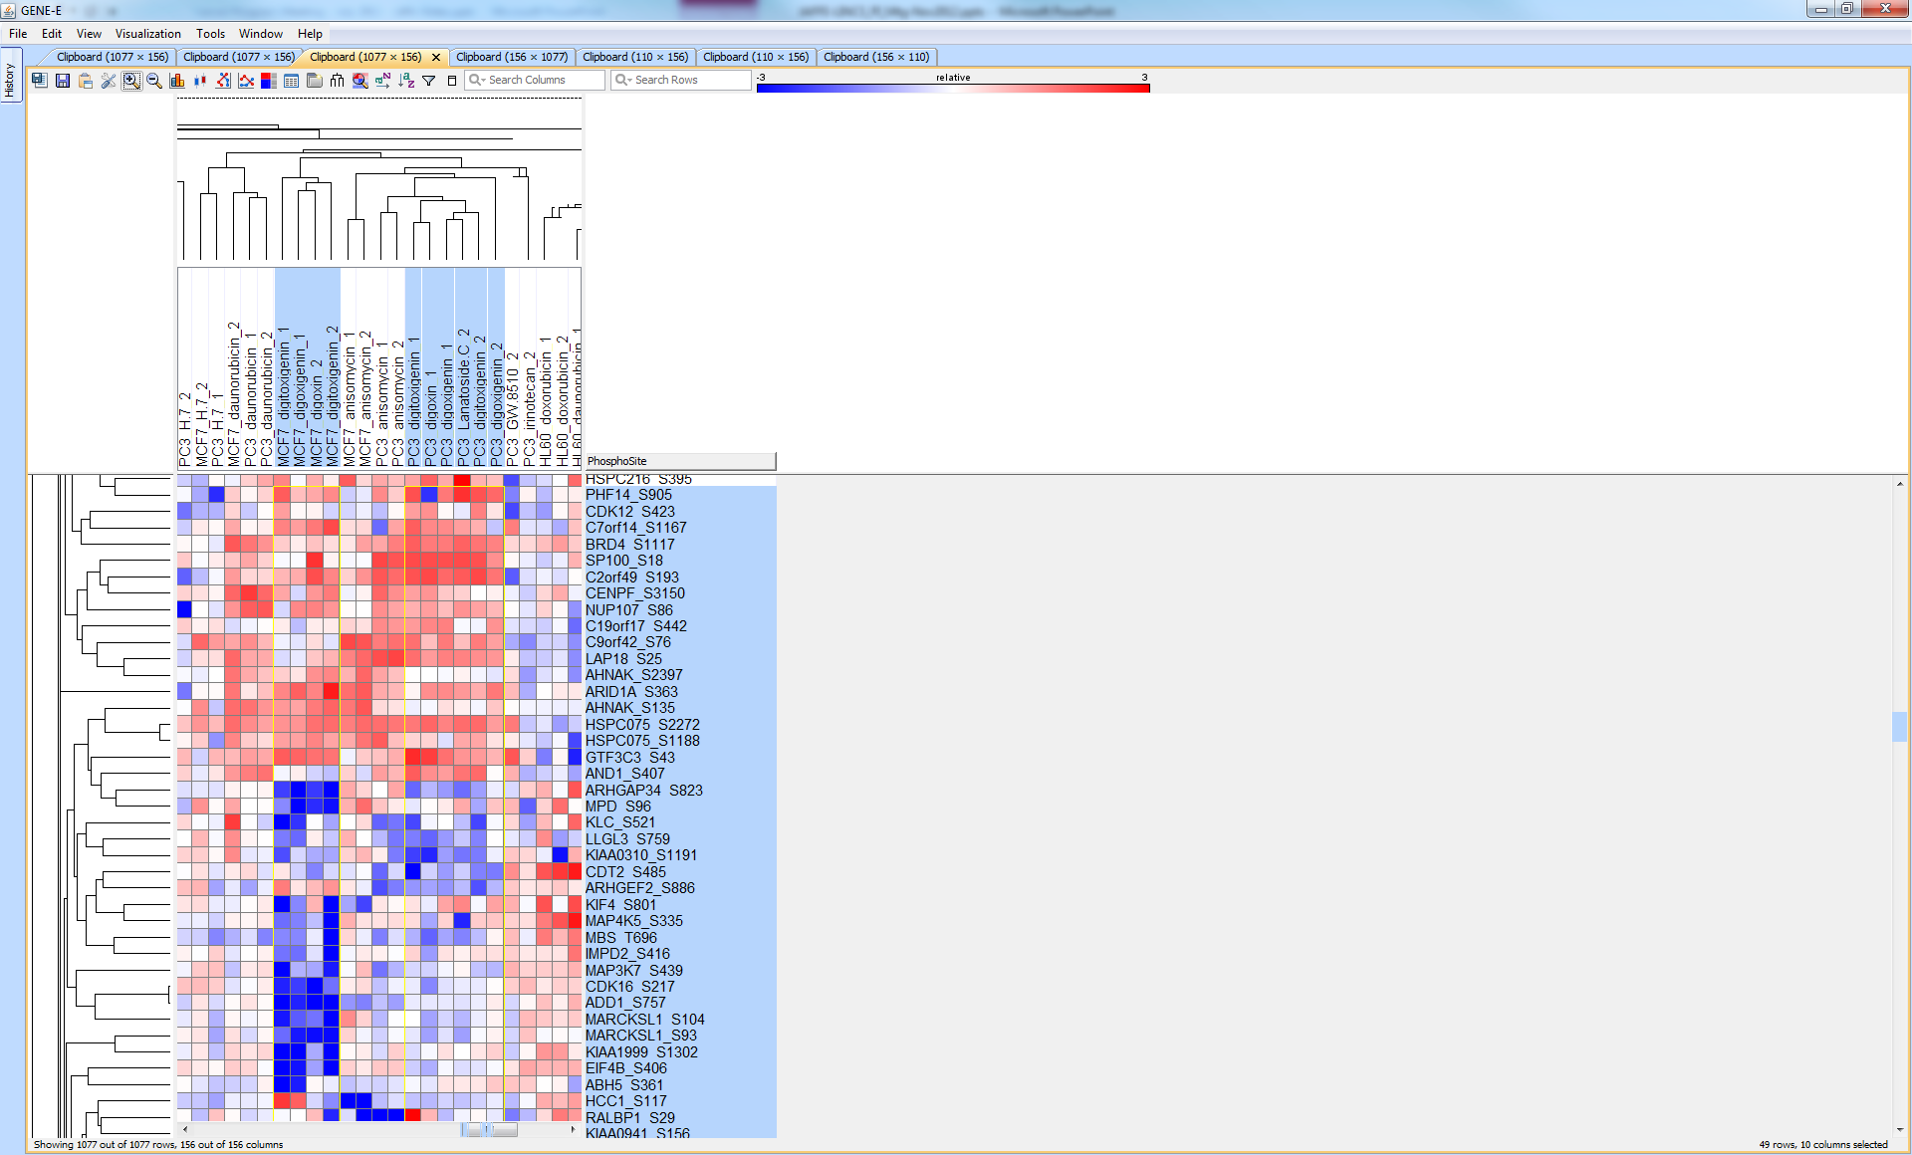
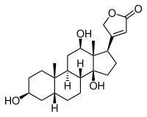
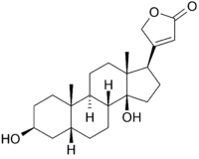
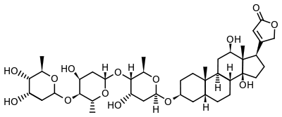
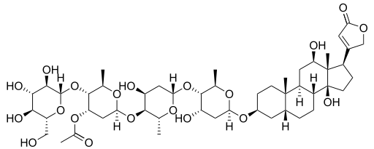
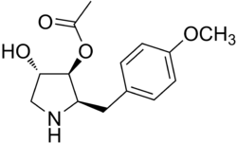
Signals group related compounds and replicates
Digoxigenin
Digitoxigenin
Digoxin
Lanatoside C
Anisomycin

Slide 34
Will it work?
Are there a set of phosphosites that we can (almost) always observe?
Do these phosphosites behave in interesting ways in response to perturbations?
Do we gain anything over gene expression measurements?
Can we pick a (small) set of highly informative phosphopeptides?
Could profiling these peptides reproduce the observations of a deeper experiment?
Is the assay generally useful?

Slide 35
Phospho-state adds value over gene expression

Slide 36
Will it work?
Are there a set of phosphosites that we can (almost) always observe?
Do these phosphosites behave in interesting ways in response to perturbations?
Do we gain anything over gene expression measurements?
Can we pick a (small) set of highly informative phosphopeptides?
Could profiling these peptides reproduce the observations of a deeper experiment?
Is the assay generally useful?

Slide 37
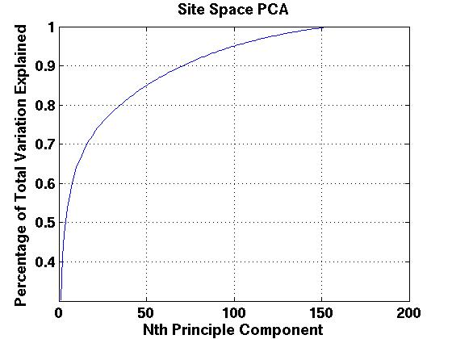
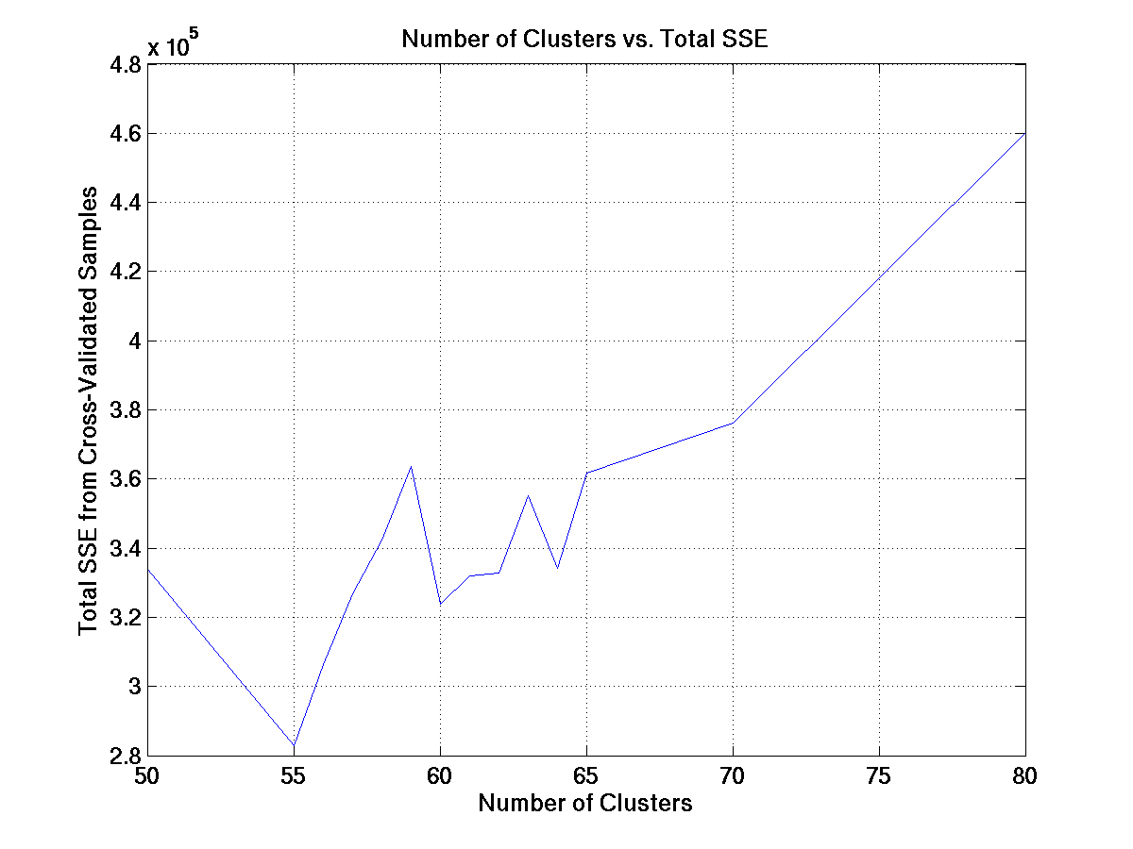
Determining the Right Number of Groups to Monitor
Each group should contain phosphopeptides with similar patterns
PCA and HC methods suggest ~50 clusters are optimal
Further refinement by hierarchical clustering leads to 55 clusters
We can choose 2 probes per cluster to build redundancy into assay

Slide 38
Principles for picking group representatives
# sites (1 is best)
2. Missed cuts (0 is best)
3. C and M count (0 is best)
4. Observability (156 is best)
5. Localization (1 is best)
6. Length (shorter is better)

Slide 39
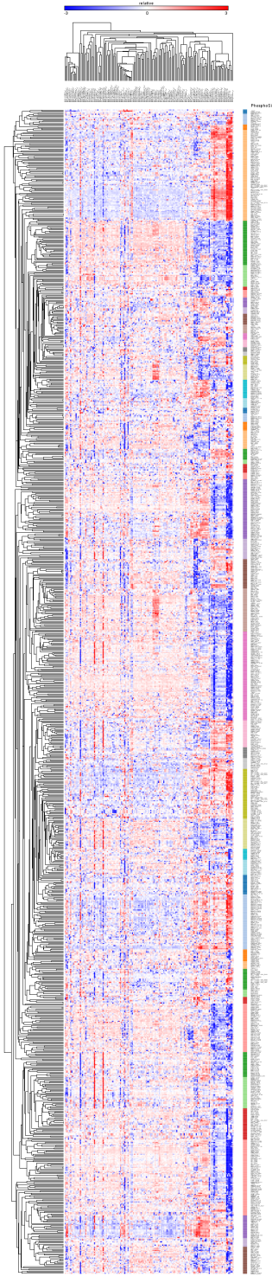
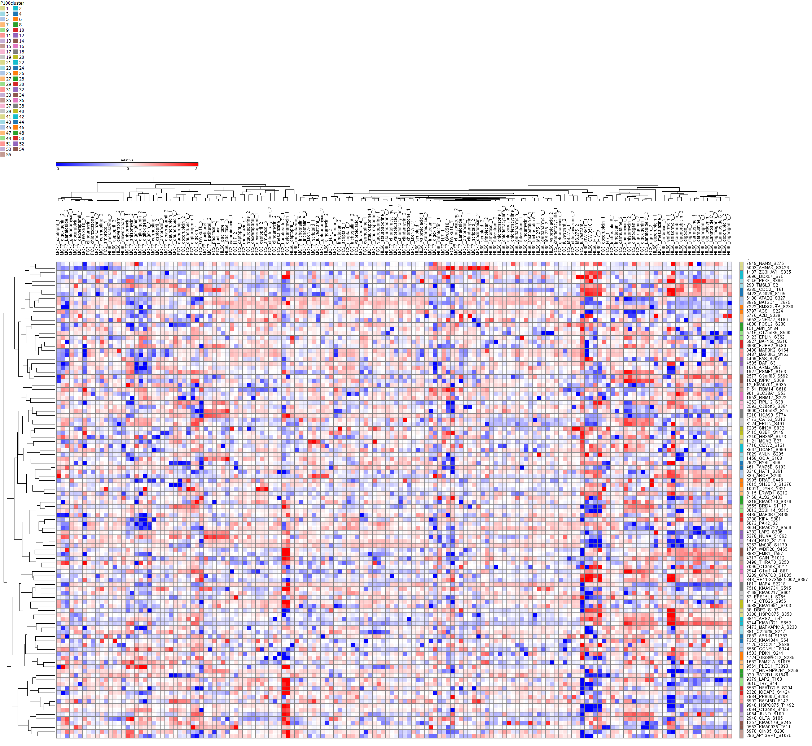
Dimensionality reduction: >1000 to 55 with 2x probe redundancy
Roger Hu

Slide 40
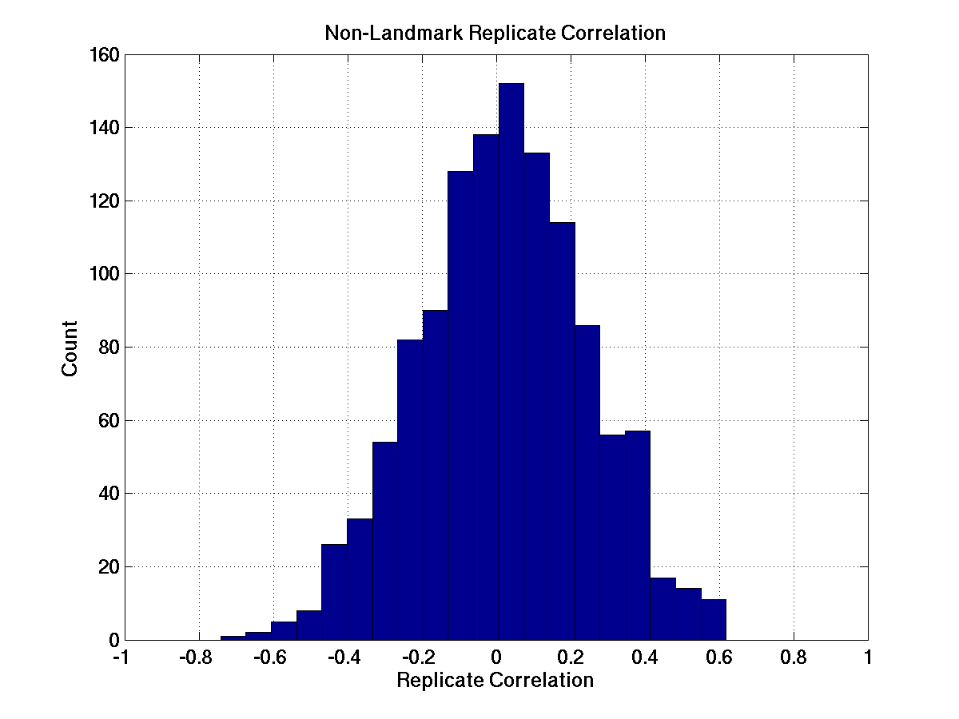
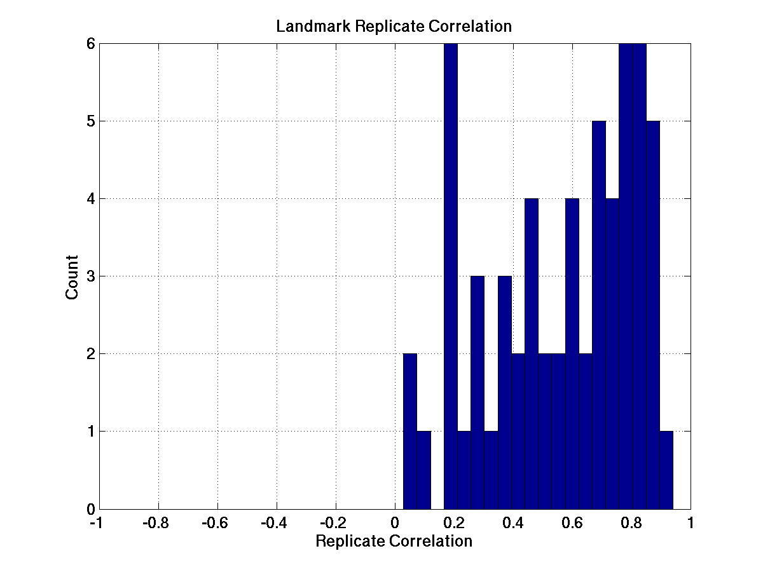
Probeset recalls replicates significantly better than random
Random Probes
P100 probes
Looks like it is going to work.

Slide 41
Will it work?
Are there a set of phosphosites that we can (almost) always observe?
Do these phosphosites behave in interesting ways in response to perturbations?
Do we gain anything over gene expression measurements?
Can we pick a (small) set of highly informative phosphopeptides?
Could profiling these peptides reproduce the observations of a deeper experiment?
Is the assay generally useful?

Slide 42
To be continued…
But first, a hackathon

